Slide 1

Sales Data Analysis and Visualization of Online Retail Dataset Using R (Major Project Presentation)
Presented By: Ashwinjeet Sandhu O23MCA110142

Slide 2
Project Overview
Objective: Analyse and visualize e-commerce sales data using R.
Dataset: Online Retail dataset containing transactions of a UK-based online store.
Goal: Extract insights such as top customers, revenue trends, and product demand.
Tools Used: R, RStudio, and popular data science libraries (dplyr, ggplot2, etc.)

Slide 3
Problem Statement
E-commerce businesses generate large volumes of sales data daily.
Making sense of this data is crucial for understanding customer behavior and improving business decisions.
Raw data often contains missing, inconsistent, or redundant entries.
There is a need to clean, analyze, and visualize this data to extract meaningful insights.
Businesses often lack clear visibility into top-performing products and high-value customers.
Visual representation of data helps in faster and more informed decision-making.

Slide 4
Objectives of the Project
To clean and preprocess the e-commerce sales data for accurate analysis.
To perform exploratory data analysis (EDA) using R.
To identify top-performing products and top customers by revenue.
To analyse sales trends over time (e.g., monthly revenue).
To generate clear and interactive visualizations using R packages like ggplot2.

Slide 5
Tools & Technologies Used in the Project
Programming Language: R
Development Environment: RStudio
Data Manipulation: dplyr, readr
Data Visualization: ggplot2, scales
Date Handling: lubridate
File Format: CSV (Comma-Separated Values)
Version Control & Collaboration: Git, GitHub

Slide 6
Software Requirements
R Programming Language – version 4 or higher
RStudio IDE – preferred for script execution and visualization
Required R packages:
dplyr – For data manipulation
ggplot – For data visualization
lubridate – For date-time handling
readr – For importing data
scales – For formatting values in plot
Operating System – Compatible with Windows, Linux and macOS

Slide 7
Hardware Requirements
Processor: Dual-core or higher (Intel i3/i5 or AMD equivalent
RAM: Minimum 4 GB (8 GB recommended for smooth performance
Storage:
At least 2 GB free space for R, RStudio, and project files
Additional space for data storage and output images
Display: 1366x768 resolution or higher (for clear visualization)
Internet Connection: Required for downloading packages and GitHub access

Slide 8
Data Description
Dataset Source: Online Retail Dataset
Total Records: 541909
Columns:
InvoiceNo: Unique transaction Identifier
StockCode: Product code
Description: Product name
Quantity: Number of items sold
InvoiceDate: Date and Time of transaction
UnitPrice: Price per item
CustomerID: Unique customer Identifier
Country: Customer’s country of residence

Slide 9
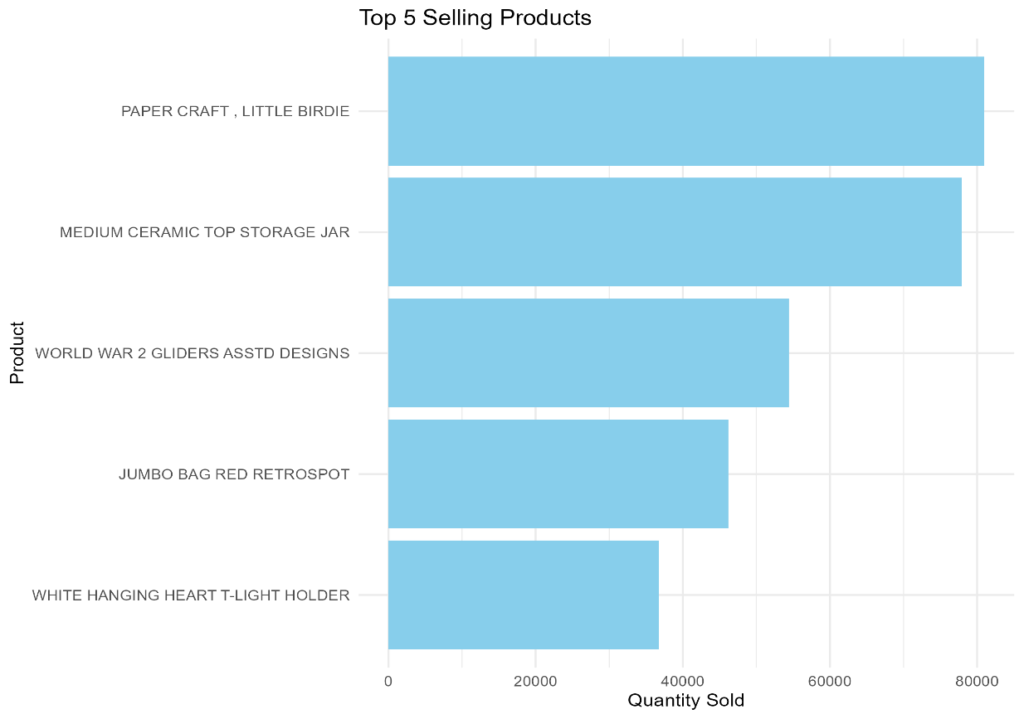
Top 5 Products by Revenue
This bar chart displays the top 5 products that generated the highest revenue
Helps identify bestselling items contributing significantly to total income
Useful for inventory planning, marketing focus and customer targeting

Slide 10
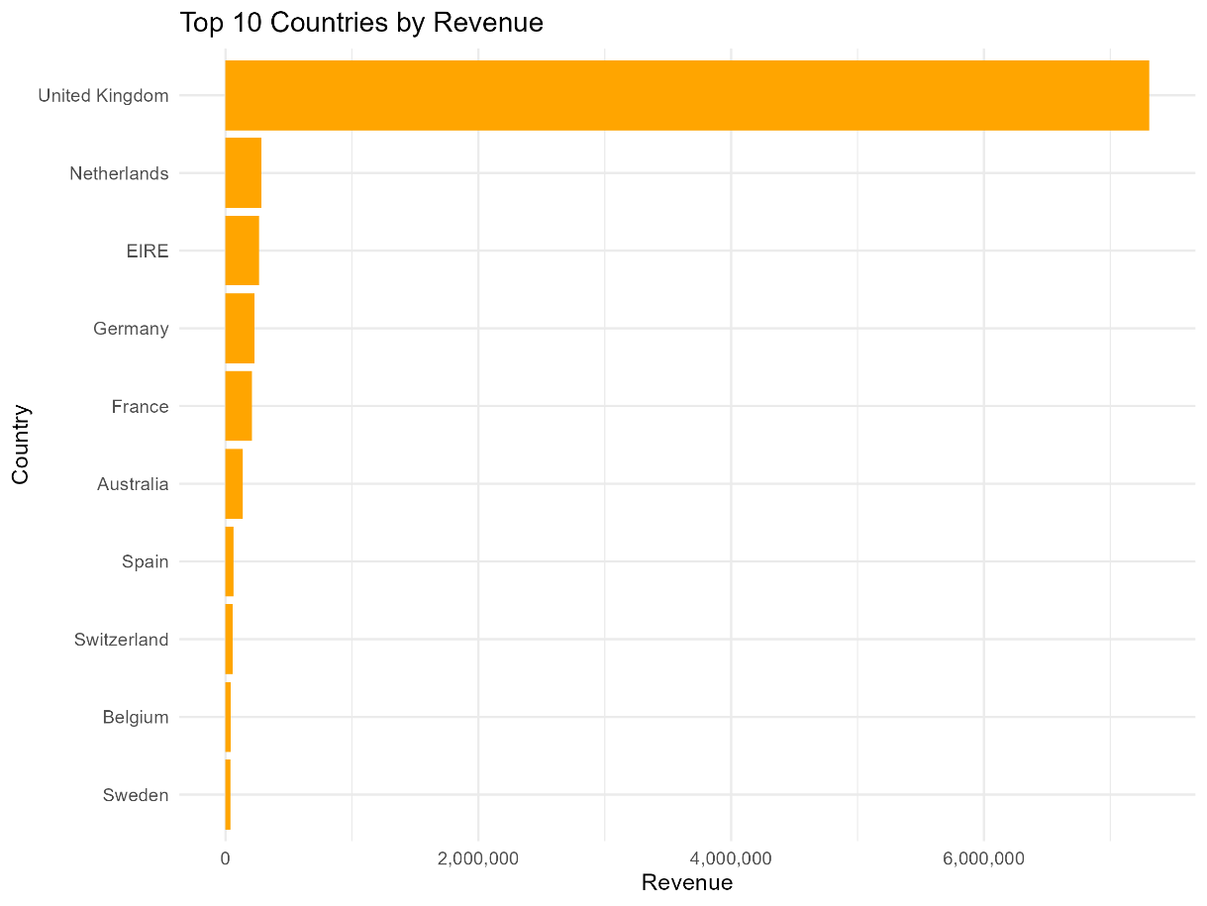
Top 10 Countries by Revenue
Highlights international market contributions to total revenue
Helps identify geographical performance trends
Useful for strategic decisions like market expansion or localized marketing
Reveals customer bases beyond the home country, aiding global planning

Slide 11
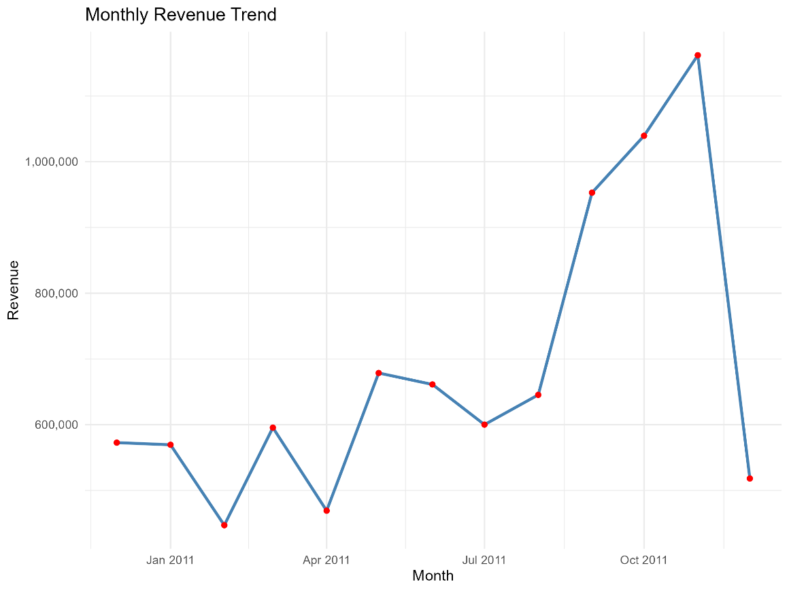
Monthly Revenue Trend
Shows sales performance over time
Helps identify seasonal patterns and sales spikes/drops
Useful for forecasting future revenue and understanding growth trends
Insights derived using lubridate for date parsing and ggplot2 for visualization

Slide 12
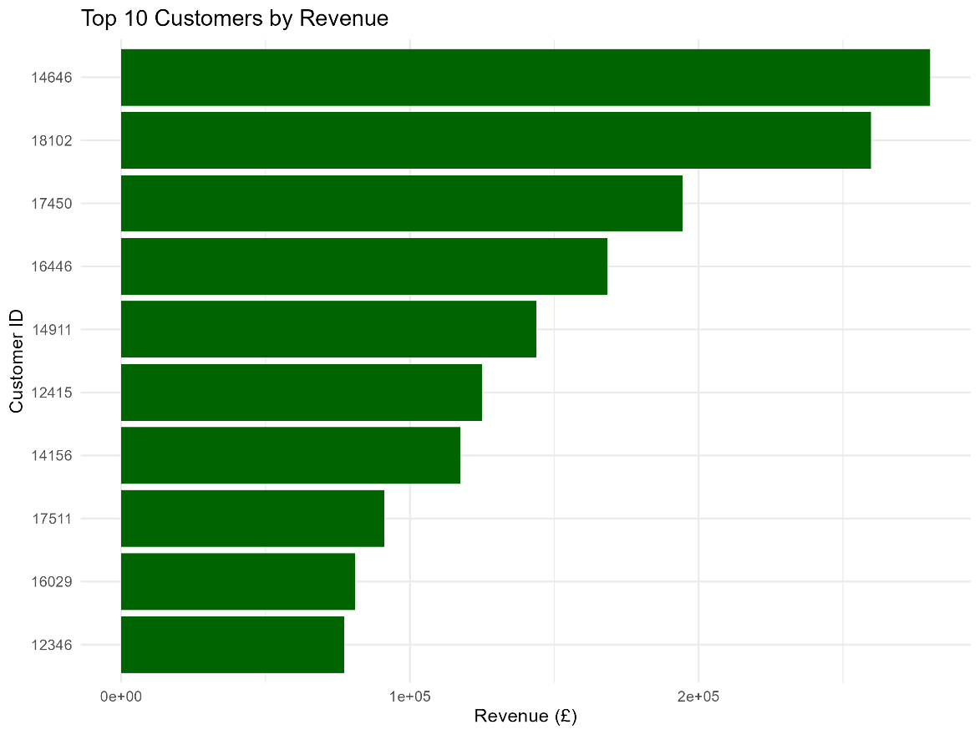
Top 10 Customers by Revenue
Displays highest paying customers by total revenue
Helps identify high-value customers for targeted marketing or loyalty programs
Revenue calculated by summing transactions for each unique CustomerID
Visualized using ggplot2 using coord_flip() for better readability

Slide 13
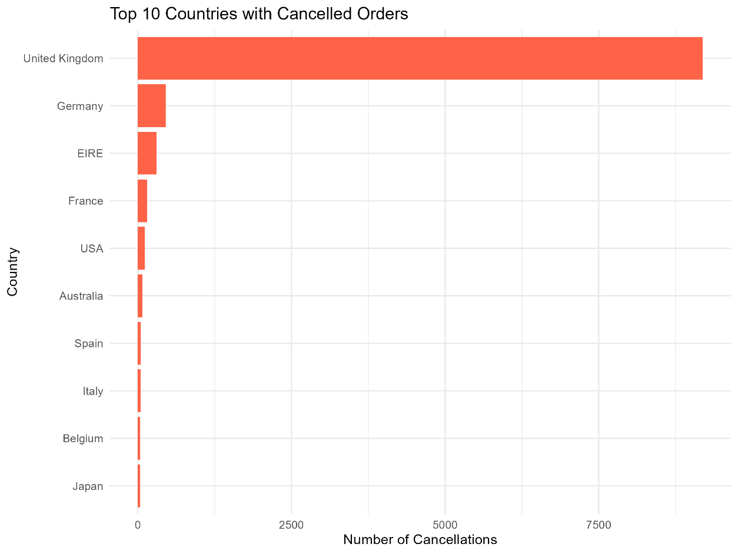
Top 10 Countries with Cancelled Orders
Highlights countries with the highest frequency of cancelled transactions
Useful for identifying potential logistics or customer satisfaction issues
Data filtered where Quantity < 0 to represent cancelled items
Enables the business to take targeted actions in regions with high return/cancellation rates

Slide 14
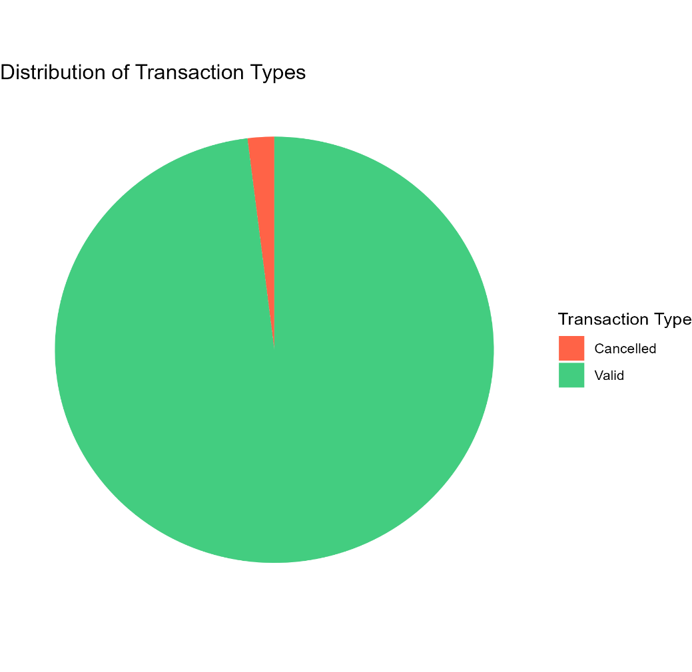
Distribution of Transaction Types
Transactions were categorized as:
Valid (Quantity > 0)
Invalid (Quantity < 0)
This pie chart visualizes the proportion of valid vs cancelled transactions
Help identify the frequency of cancellations, which is crucial for understanding customer behavior and possible operational issues
Majority of the transactions are usually valid, but cancelled transactions also form a noticeable portion of total orders

Slide 15
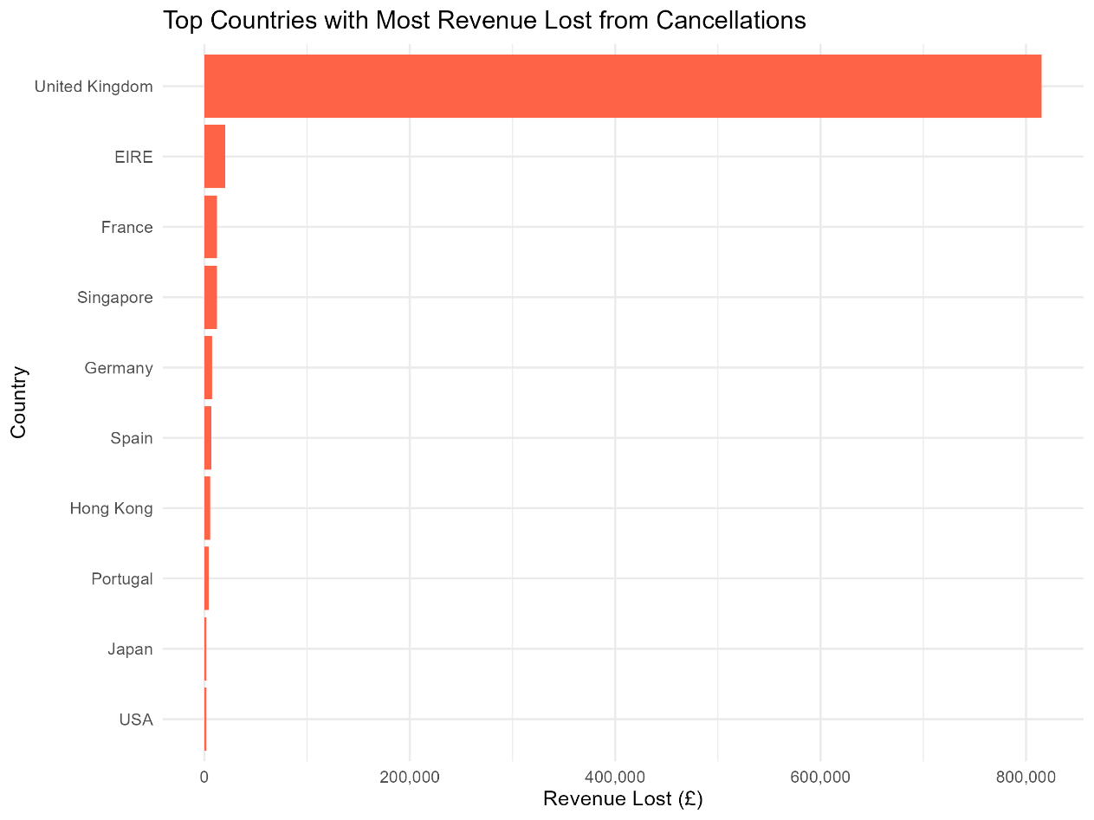
Top Countries with Most Revenue Lost from Cancellations
This bar chart highlights the top countries where the most revenue was lost due to cancelled orders
The chart helps pinpoint regions causing significant financial impact, aiding in
Investing potential causes of high cancellations
Improving operational efficiency
Enhancing customer service in high-loss regions
Cancellations were identified using transactions with negative quantities, and revenue loss was calculated accordingly

Slide 16
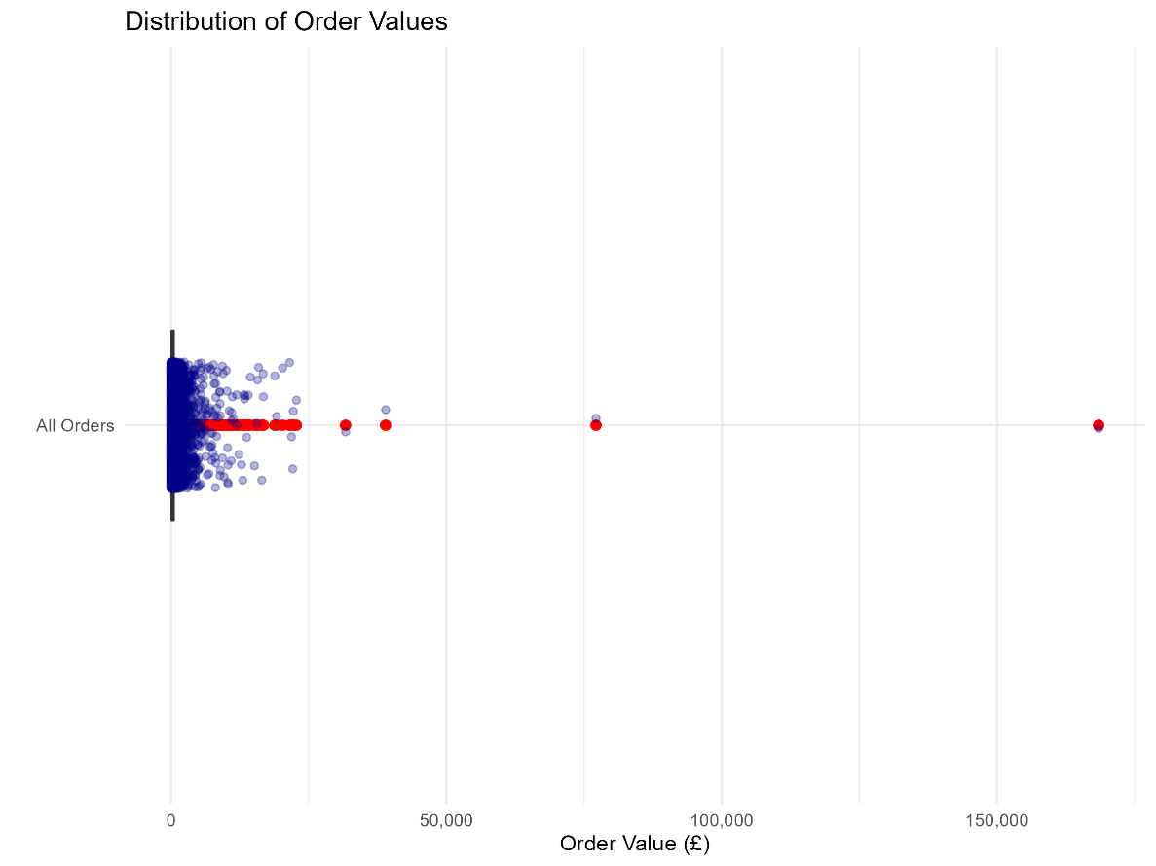
Distribution of Order Values
This visualization shows the distribution of total order values across all invoices
Each order’s value was calculated by summing the prices of items in that invoice
A boxplot is used to capture:
Median order value (central line in the box)
Interquartile Range (IQR)
Outliers
Jittered points provides a clearer picture of individual order distributions

Slide 17
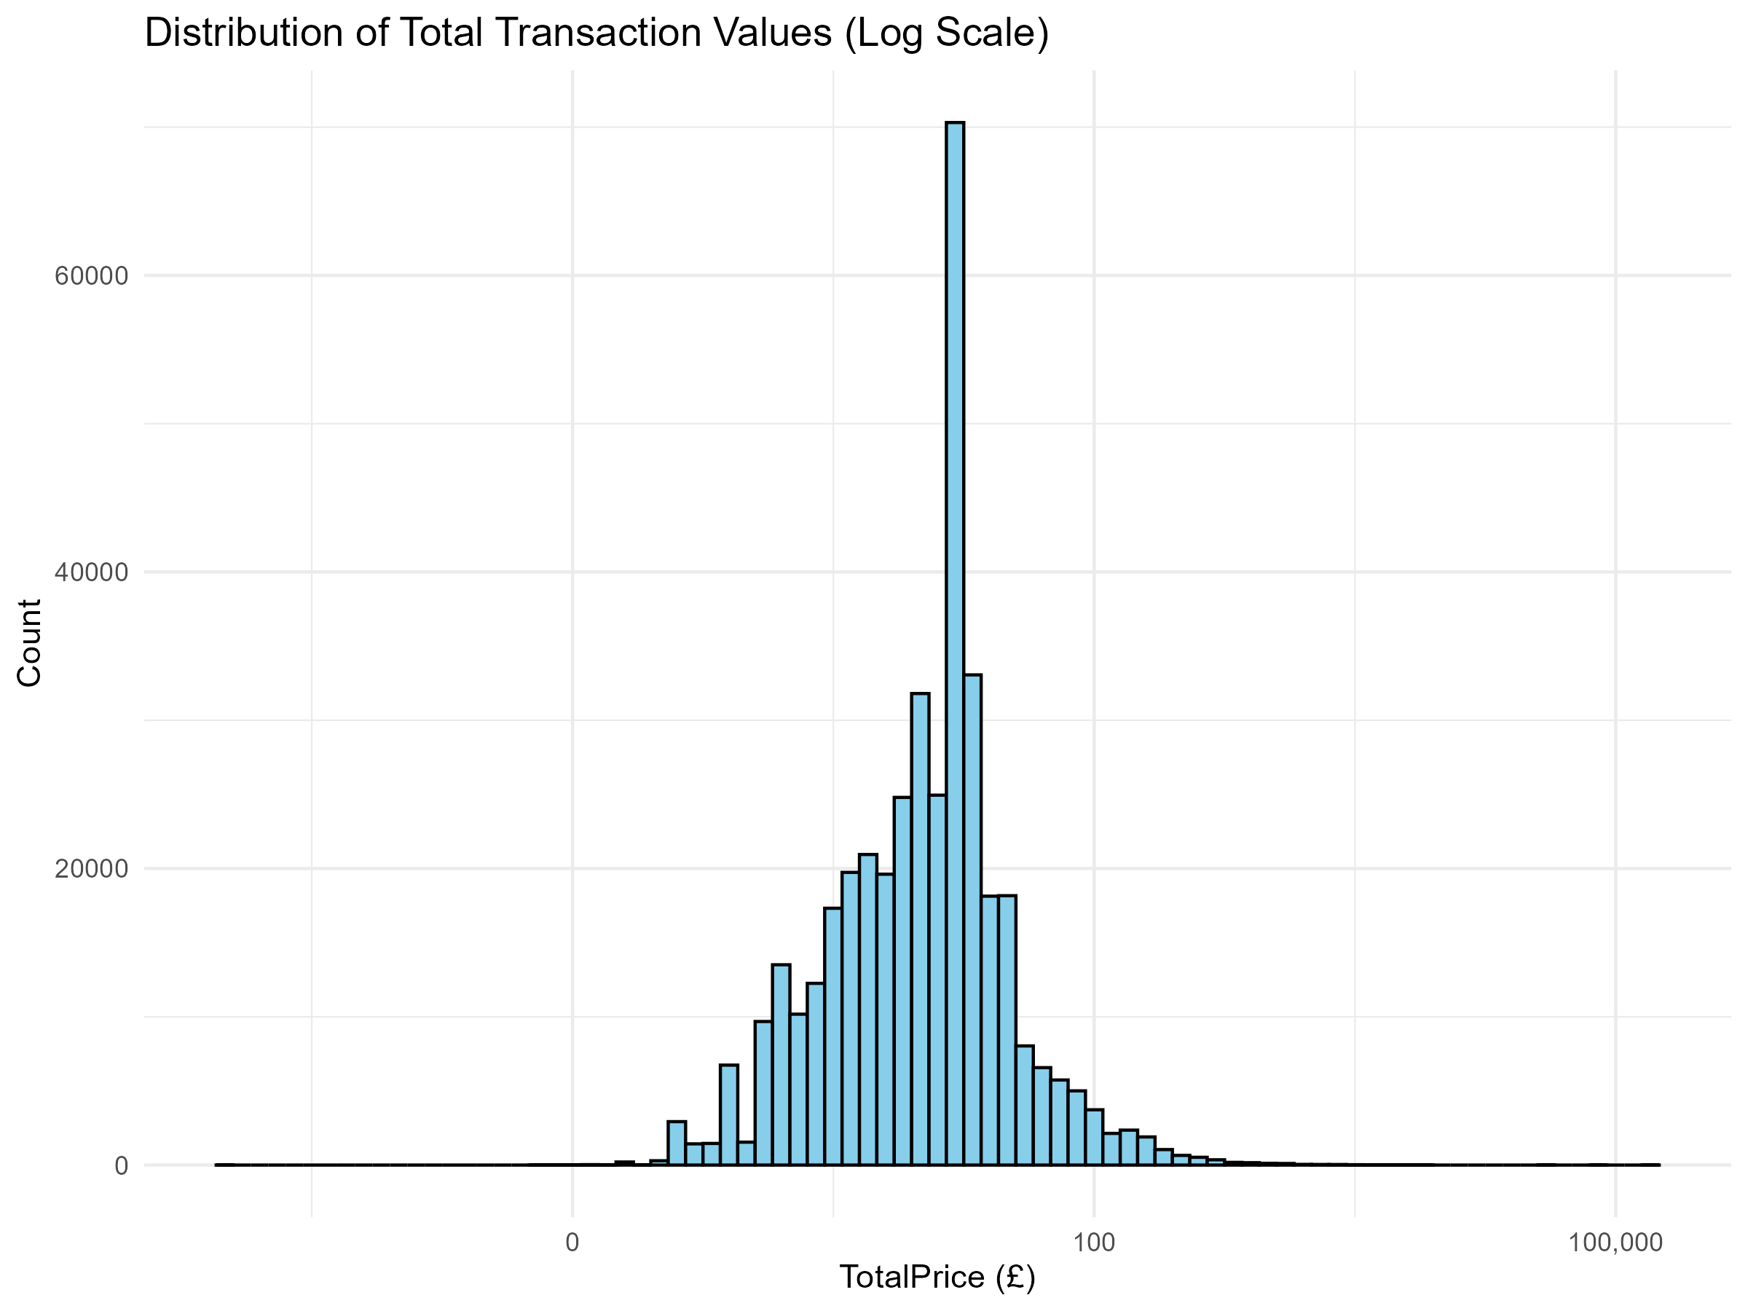
Distribution of Total Transaction Values
Show how transaction values are distributed across all orders
Log scale on x-axis improves visibility of small and large transactions
Most transactions falls within the lower price range
Highlights presence of a few high-value orders
Helps in analyzing customer spending behaviour

Slide 18
Key Insights
The UK is the largest market by revenue and number of transactions
A small number of customers contribute to a significant portion of the revenue
High cancellation rates observed in certain countries lead to major revenue losses
Most products sold are low in value, but there are occasional high-value orders
Sales trends shows seasonal spikes, likely around holidays

Slide 19
Challenges Faced
Data Cleaning: Dealing with missing values, duplicates, and invalid entries took considerable time
Data Understanding: Interpreting business context from raw transactional data was challenging
Visualizing Effectively: Choosing the right type to communicate insights clearly requires several iterations
R Programming: Faced initial difficulties in syntax and debugging in R and ggplot2
Time Management: Balancing project work with academic schedule and finalizing all components on time

Slide 20
Thank You
Presented By:
ASHWINJEET SANDHU
023MCA110142

